Slide 1

ENGLISH PREMIERE LEAGUE MATCH RESULTS How to build a betting strategy with classification
ROLEX TEAM
Alexandre Lang, Joël Kuflom, Abdul Aloraib Alsalim & Alix Muller

Slide 2
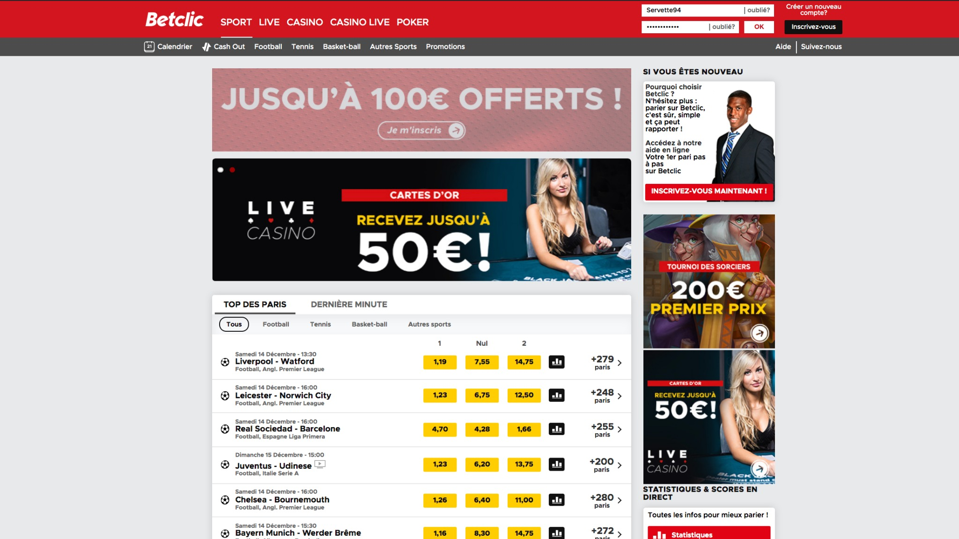

Slide 4
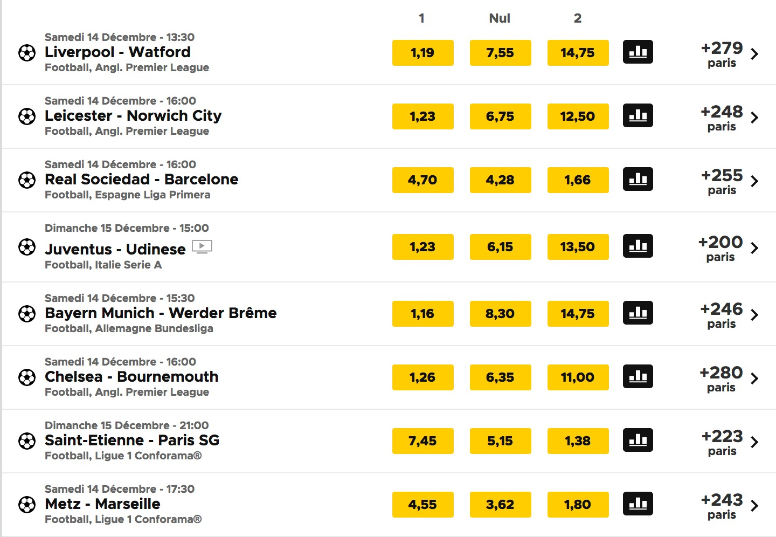
3 Odds
Liverpool wins
Draw Match
Watford wins

Slide 5
Odd if
Liverpool wins

Slide 6
Odd if
the match result is Draw

Slide 7
Odd if
Watford wins

Slide 8
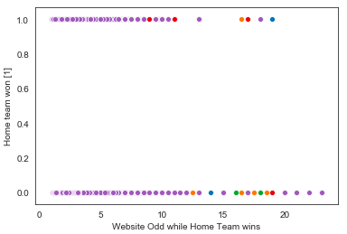
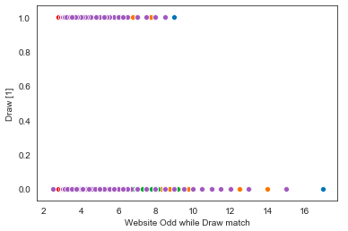
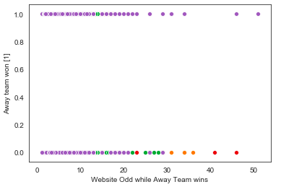
SCATTER PLOTS → Odds distribution Trends
Draw Match
Home Team WIN
Away Team WIN
Odd for Home win crossed with : 1 = Home WON 0 = Home did not WIN
Odd for Draw Match crossed with : 1 = Draw 0 = No Draw
Odd for Away win crossed with : 1 = Away WON 0 = Away did not WIN

Slide 9
THE METHODOLOGY for Classification
Logistic Regression
Odds
Match Statistics
One for...
Decision Trees
EQUATIONS
MODELS
VARIABLES
Home WINS Draw Away WINS
Odds
Match Statistics

Slide 10

BEST MODEL RESULTS W LOGISTIC REGRESSION WITH MATCH STATISTICS
Default rate
Accuracy
Precision
46%
69%
a
71%
Of Home teams
actually won
Of the predictions
were correct
Of True Positives over Actual Positives
When we say the Home team will win...
71%
really wins!

Slide 11

CONCLUSION W THE FINAL RESULTS OF THIS ANALYSIS
Complex to predict match results, however:
Better to use Match statistics over Odds → EMOTIONAL STIMULATION (NUMBERS)
Better to use Logistic Regression over Decision trees → MORE ACCURATE WHEN GOOD DISTRIBUTION
... with improvements and more variables,
this model could be used to build a prediction website!

Slide 12
THANK YOU

